Slide 1
Password Management System
Your secure password is your first line of defense!
Project By:
Group Name: Team Oops! Team Members: Akansha Gupta, Vaishali Jeenwal, Akshitha Kamshetty Information Systems, Northeastern University gupta.akan@northeastern.edu, jeenwal.v@northeastern.edu, kamshetty.a@northeastern.edu

Slide 2
Agenda
Problem Description
System Design
Analysis
Implementation
Conclusion & Future Work
Evaluation
Discussion
Job Assignment
Refrences
Demo

Slide 3
Problem Description
Managing passwords in the digital age presents significant challenges and security risks
Remembering and organizing passwords, often resulting in weak or reused passwords

Slide 4
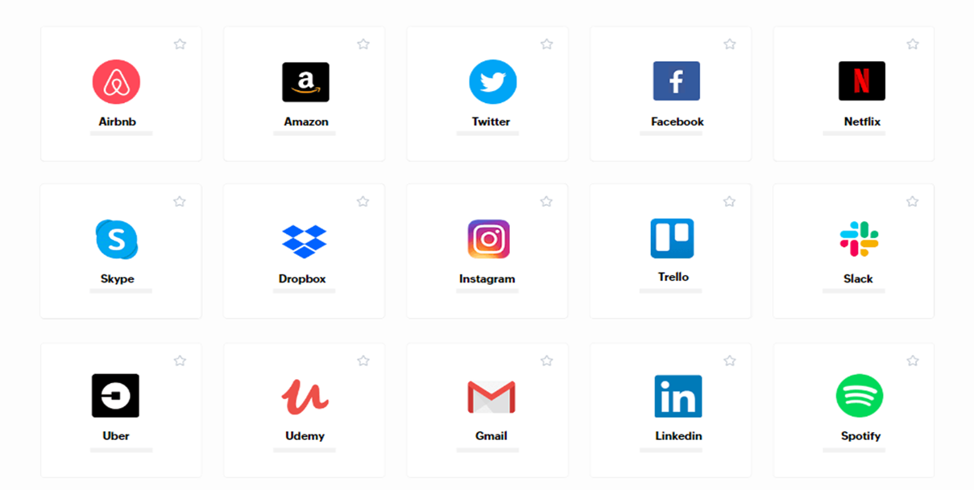
Motivation Of The Project
The surge in online services underscores the urgency of strong password management
Rising cyberattacks, data breaches, and identity theft accentuate the need for a reliable solution to protect sensitive information

Slide 5
Scope Of The Project
Our project focuses on developing a robust Password Management System to address these challenges.
The system will provide users with an efficient and secure means of creating, storing, and retrieving passwords, ultimately enhancing their online security posture.
Send an alert notification to the user if the password hasn't been changed for the last 3 months

Slide 6
Purpose Of The Project
Design and implement a user-friendly Password Management System
Prioritizing: Emphasizing both security and convenience
Centralized Platform: Providing a single platform for password management
Simplify User Experience: Making password management easy and efficient
Minimize Risk: Reducing the likelihood of unauthorized access to personal account

Slide 7
Key Objectives
Implement strong encryption techniques to ensure the confidentiality of stored passwords.
Create a seamless process for generating complex passwords and storing them securely.
Design an intuitive and visually appealing user interface to enhance usability.
Enable secure and efficient retrieval of passwords when needed.

Slide 8
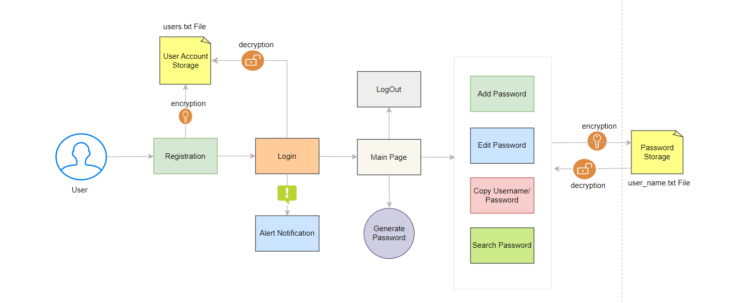
System Design
High Level Design

Slide 9
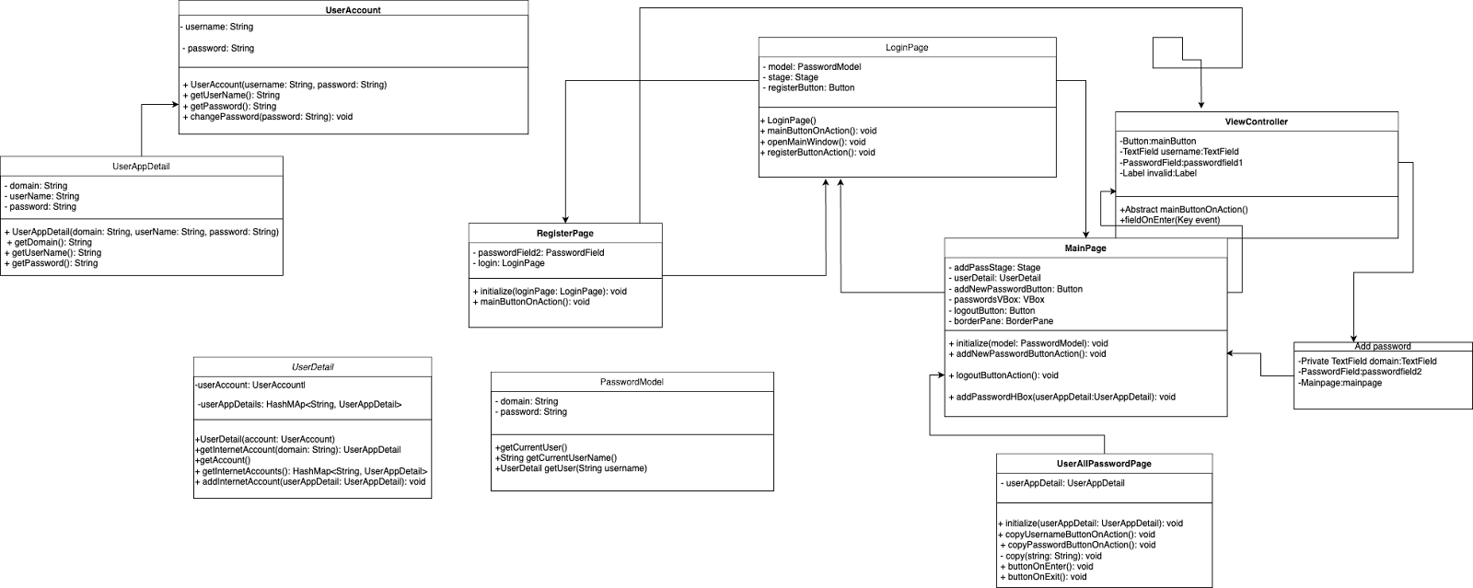
UML Class Diagram

Slide 10
Analysis
Previous Works/Findings:
PMF: Semantic Annotations Elevate Password Manager Efficiency" by Quentin Stafford-Fraser enhances password managers with semantic annotations
Investigating the Ideal Password Management System" by Shivam K. Shinde and Mohit V. Deshpande explores design and features.
Comparing Our Solutions to Given References.
Unlike past research, our project creatively merges real-time password expiration alerts with the security focus of "Password-Manager Friendly (PMF): Semantic Annotations."
Moreover, while "A Study for an Ideal Password Management System" explores user preferences, our solution uniquely prioritizes proactive security.

Slide 11
Implementation
Architecture:
Utilized the Model-View-Controller (MVC) architectural pattern.
Components: Controller, DAO (Data Access Object), and View.
Data Structures:
Utilized Collections, ArrayList and HashMap for efficient data storage and management.
Programming Language & Libraries:
Java as the primary programming language.
JavaFX Library for building graphical user interfaces.
Scene Builder to create UI layouts using FXML.
Managed time-related operations using TimeUnit.
Integrated AWT Toolkit and Clipboard for copying passwords.
Utilized java.util.Date Library for handling time-sensitive operations
Password Generation and Encryption:
Generated secure passwords using SecureRandom and Base64.
Implemented password encryption using Java's Cipher and SecretKey.

Slide 12
Implementation Cont.
Error Handling and Exception Management:
Implemented try-catch blocks to manage exceptions
Handled FileNotFoundException and IOException
User Interaction:
Created user interfaces using JavaFX and FXML
Applied principles of Abstract Class and Inheritance for UI components
Secure Key Generation:
Generated secure keys using KeyGenerator for encryption.
File Handling and Data Management:
Handled IOException for file operations.
Stored user data in files with proper error handling.
Tools Used in the Project:
Eclipse
Git repository
Scene Builder
Task Management Tools: Trello (https://trello.com/).
Documentation Tools: Adobe Pdf, Google Docs, Google slide
File (txt) for storage
Data Persistence:
Implemented data persistence through File I/O operations.

Slide 13
Conclusion & Future Work
Conclusion:
Successfully developed and implemented a functional Password Management System
Enhanced Security
User-Friendly Interface
Password Expiry Notifications
Strong Password Generation
Future Work:
Browser Extension
Data Backup and Recovery
Auto filling password

Slide 14
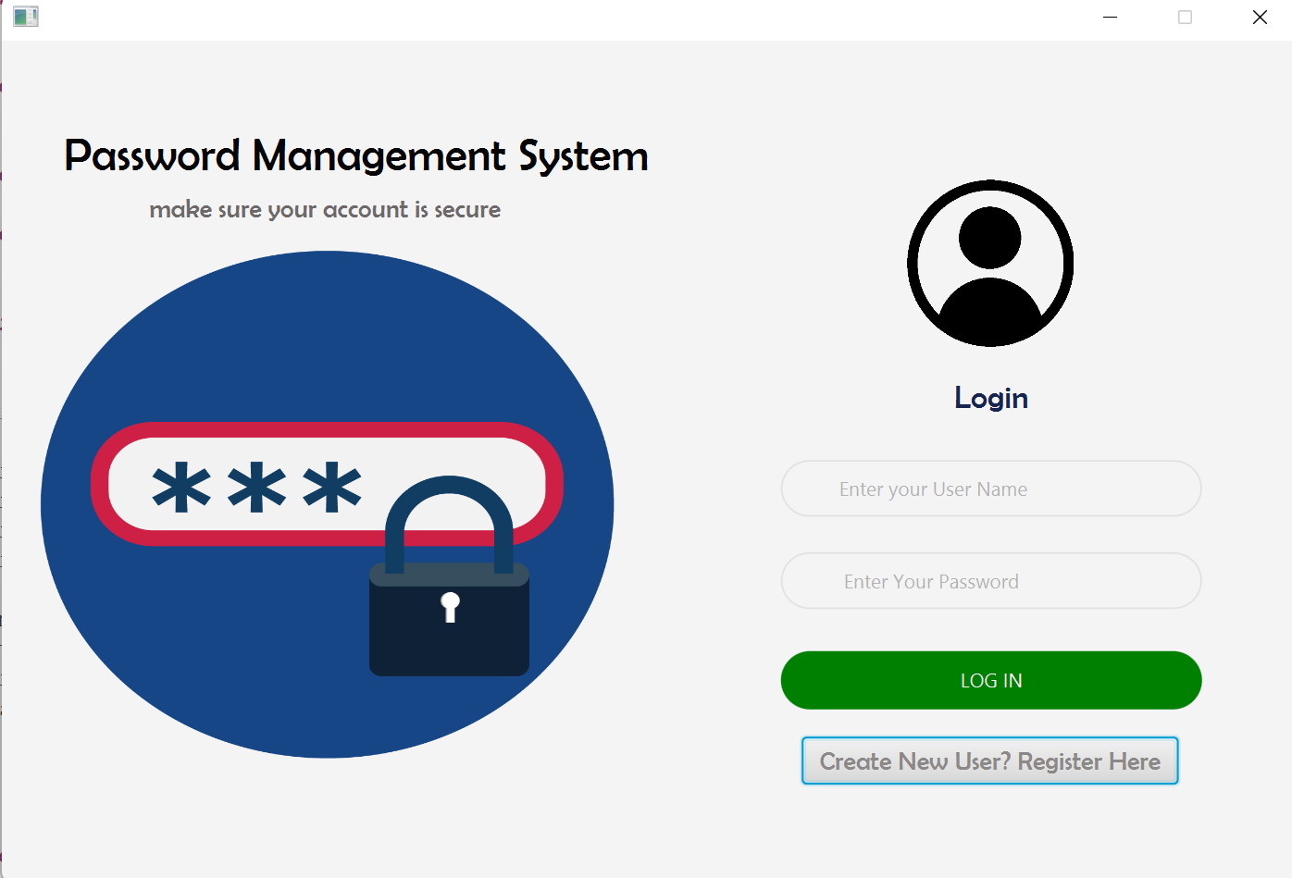
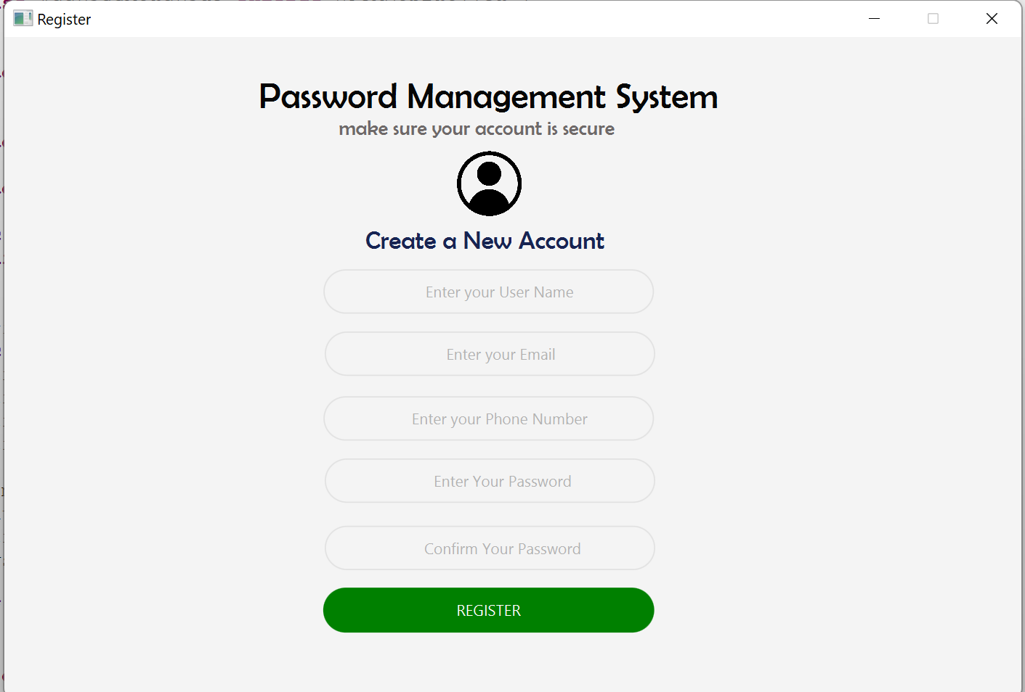
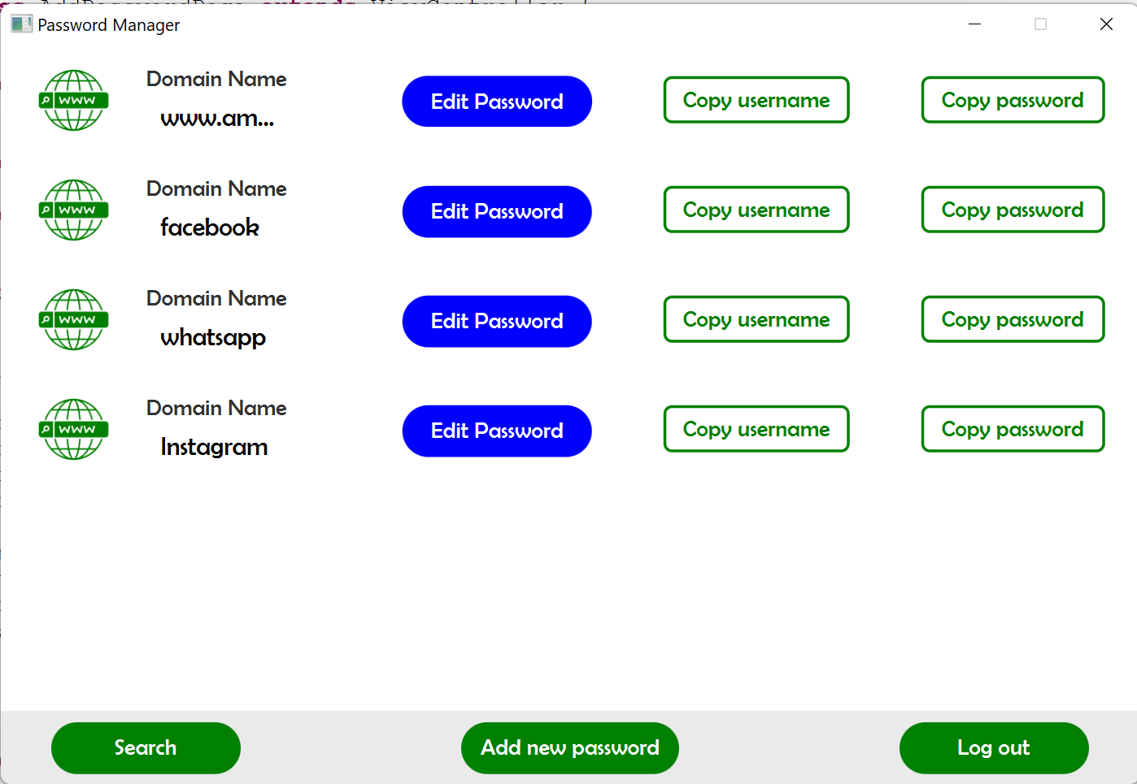
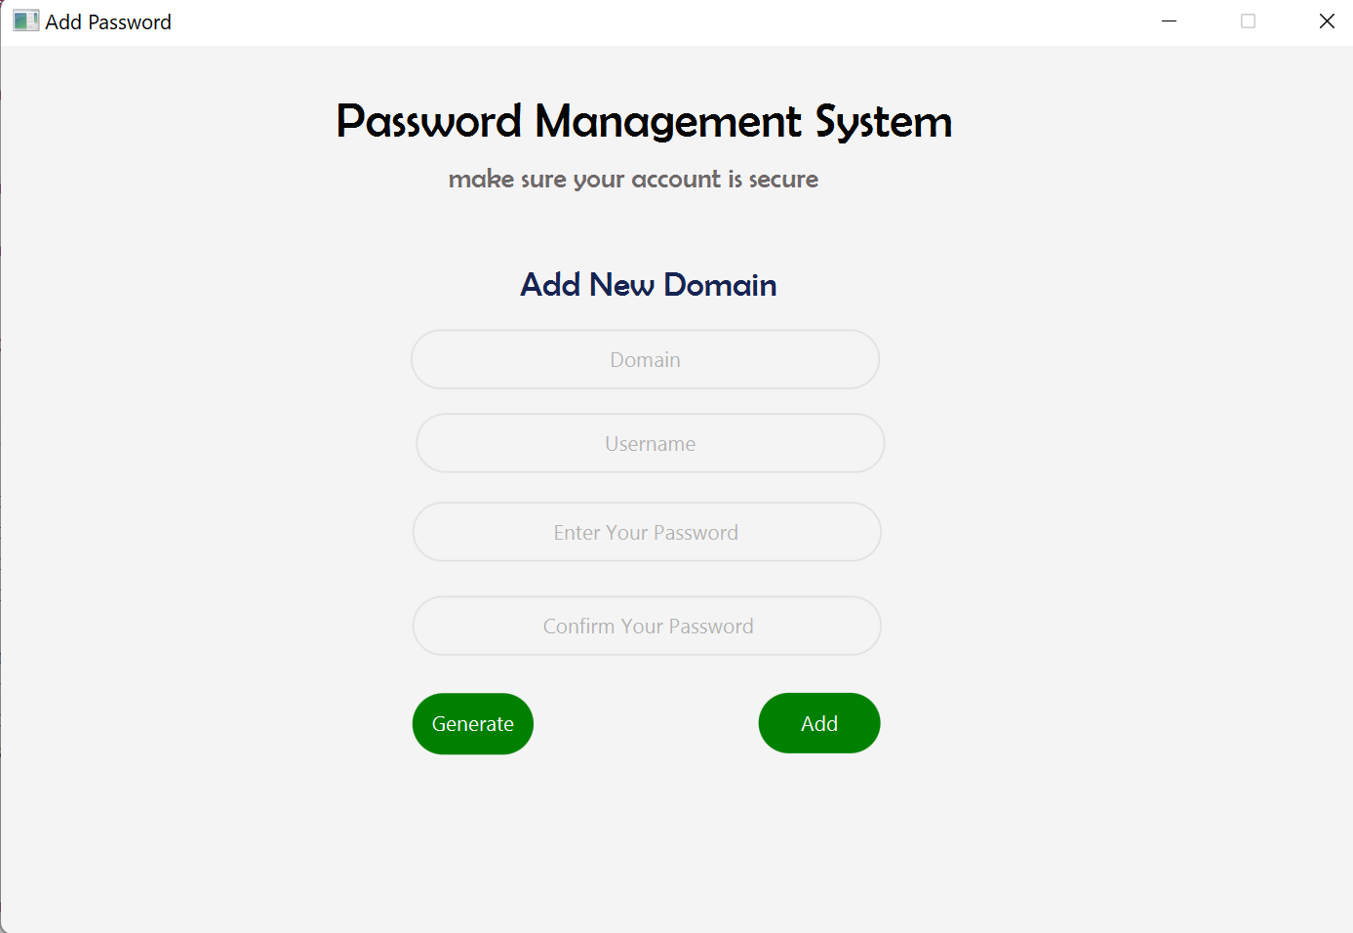
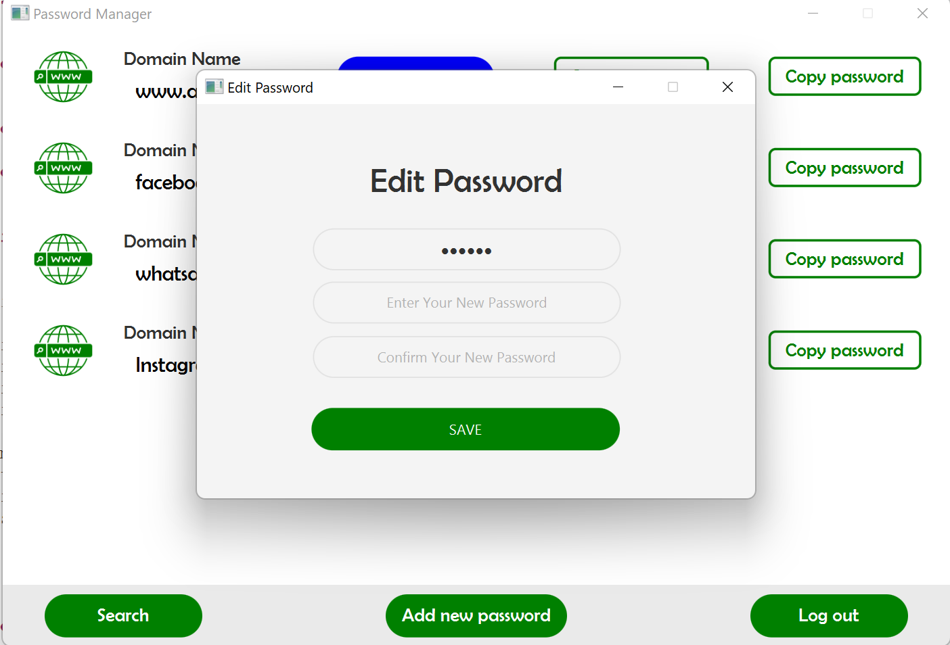
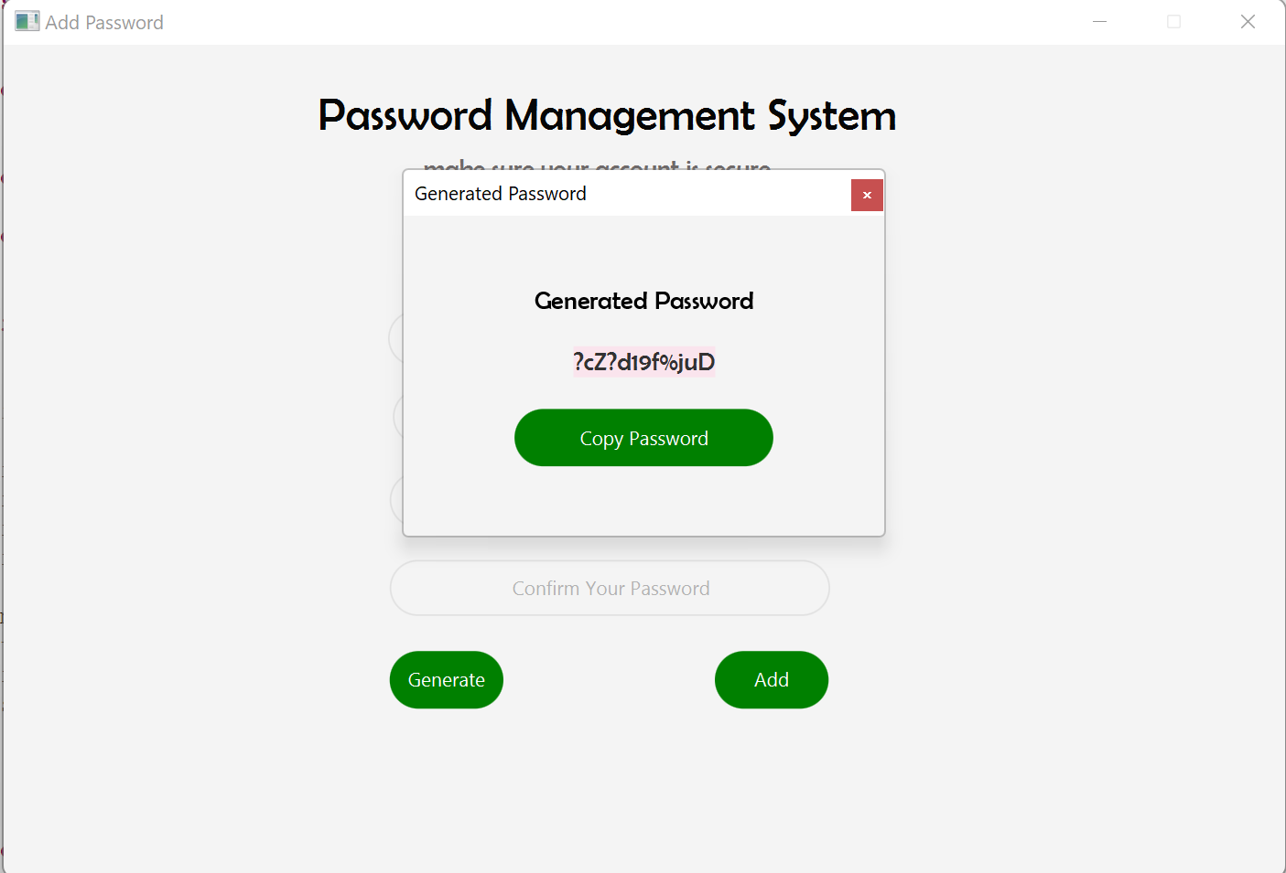
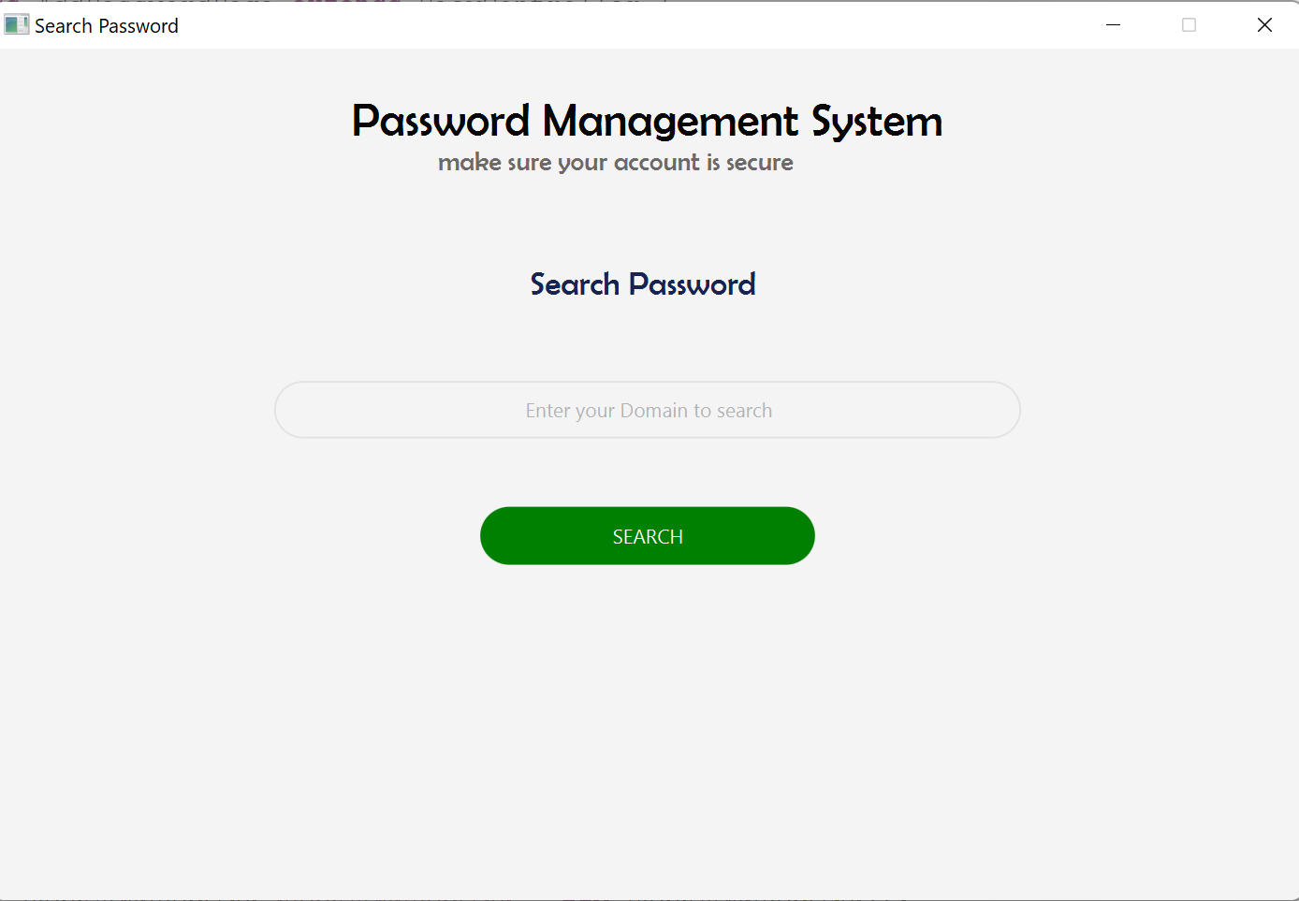
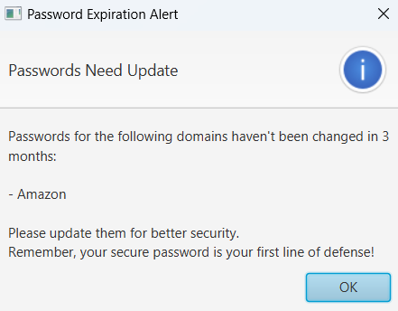
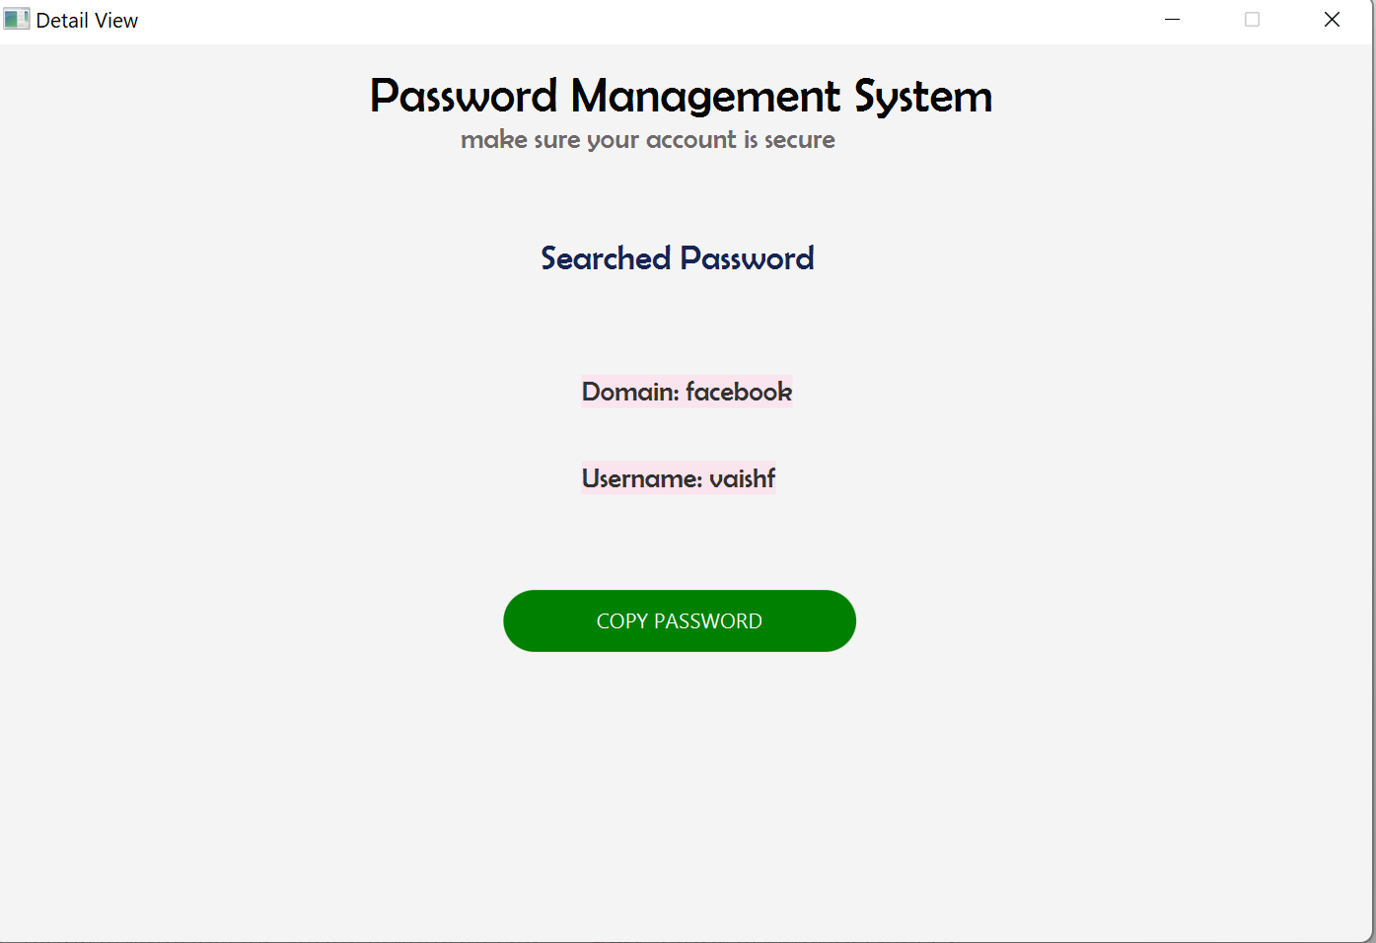
Project Evaluation
Login Page
Registration Page
Main Page
Add New Password
Edit Password
Generate Password
Search Password
Get Searched Password
Alert Notification

Slide 15
Discussion & Outcomes
Discussion:
Created a secure, user-friendly password manager app for efficient project password management.
Enhances security by storing, editing, and organizing online credentials, reducing password risks.
This discussion covers key features, contributions, challenges, and potential improvements of the project.
Outcomes:
The app fulfills a critical need for strong digital password management.
By offering a secure platform for credentials, the app enhances cybersecurity practices.
Users are empowered to create stronger passwords, avoid password reuse, and proactively update passwords as needed.
Proactive password security reduces unauthorized access and data breach risks.

Slide 16
Job Assignment
Akansha Gupta:
Password Encryption and Decryption implementation
Search Password Implementation
Generate Password Implementation
Alert Notification to change Password implementation
Copy Password Implementation
Add Password Implementation
Main Page Implementation
Error handling and exception management
High level Design
UML Flow Diagram for System Design
File Handling and Data Management
Maintained Version Control – Git
Prepared PPT and Report Document
Coordination with Mentor(TA) and Team
Team Code Review

Slide 17
Job Assignment Cont.
Vaishali Jeenwal:
Implemented Base Project – Structured the project
UI Design for all pages
Register Page Implementation
Login Page Implementation
Edit Password Implementation
Add Password Implementation
Main Page Implementation
Error handling and exception management.
File Handling and Data Management
Maintained Version Control – Git
Prepared PPT and Report Document
Coordination with Mentor(TA) and Team
Team Code Review

Slide 18
Job Assignment Cont.
Akshitha Kamshetty:
Password Strength analysis
Maintained Version Control – Git
Report Document
UML Class Diagram for System Design
Coordination with Mentor(TA) and Team
Team Code Review

Slide 19
References
Password-Manager Friendly (PMF): Semantic Annotations to Improve the Effectiveness of Password Managers
By Quentin Stafford-Fraser
https://www.academia.edu/48084224/Password_Manager_Friendly_PMF_Semantic_Annotations_to_Improve_the_Effectiveness_of_Password_Managers
A Study for an Ideal Password Management System
By Shivam K. Shinde, Mohit V. Deshpande
https://www.ijraset.com/research-paper/an-ideal-password-management-system

Slide 20
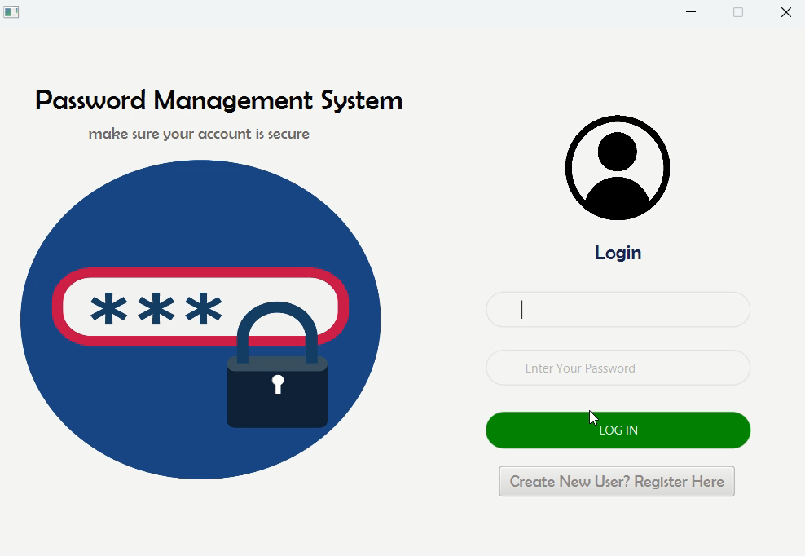
Demo

